Slide 1

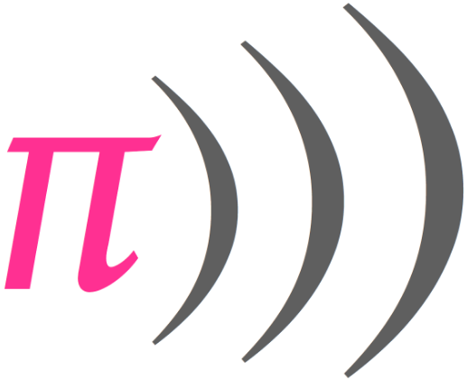
Sonic Pi

Slide 2
Learning Objectives
The chord function
The scale function
The choose function
The tick function
Rings
Variables

Slide 3
Generating a sound
On this chapter we’ll learn a bit more about how to use chord and scale, iterate through lists and use variables.
Cord: The chord function gives you the notes of a certain chord. For example:
play (chord :c, :major).choose
  # plays a random note of the C major chord (:c, :g r :f)
Scale: Scale function returns all the notes in a scale, not just the ones in a chord. For example:
play (scale :c, :major).choose
  # plays a random note of the C major scale (:c, :d, :e, :f, :g, :a or :b)
Choose: Choose function gets a random element from a list. To go through the values in a more structured manner, another function called tick is used. For example:
live_loop :arp do
play (scale :e3, :minor_pentatonic).tick, release: 0.1
sleep 0.125
end
  N/B: In this example, we are just grabbing the scale E3 minor pentatonic and ticking through each element by adding a .tick to the end of the scale declaration.

Slide 4
Tick function
This tick is local to the live loop, so each live loop can have its own independent tick.
For example:
live_loop :arp do
play (scale :e3, :minor_pentatonic).tick, release: 0.1
sleep 0.125
end
live_loop :arp2 do
use_synth :dsaw
play (scale :e2, :minor_pentatonic, num_octaves: 3).tick, release: 0.25
sleep 0.25
end

Slide 5
Rings
A ring is a special list that starts over when you get to the end. scale and chord both return a ring.
Sometimes one needs to create a list and turn it into a ring by calling .ring or using the ring creator. Ticking through an ordinary list also stops at the end of the last note and this is why rings are useful.
See the two examples below:
  puts [1, 2, 3, 4].ring #=> (ring 1, 2, 3, 4) (This is a list that has been turned into a ring)
  puts (ring 1, 2, 3, 4) #=> (ring 2, 2, 3, 4)
Ring applied:
live_loop :arp do
play [:c, :e, :d, :f].ring.tick, release: 0.1
sleep 0.125
end

Slide 6
Rings and Ticks
The example below is a bit more complex. It has a list or chords that are turned into a ring and ticked through.
live_loop :keys do
use_synth :blade
play [(chord :Ab, :major7), (chord :Db, :major7), (chord :Bb, :minor7), (chord :Eb, '7')].ring.tick, attack: 0.1, release: 1
sleep 1
end

Slide 7
Variables
A variable is a bit like a box where you can store things and take things out.
Using a variable is as simple as valiable_name = variable_value. Now the variable_value is stored in variable_name.
r = [0.25, 0.25, 0.5, 1].choose
You can get the value just by typing variable_name.
For example:
live_loop :melody do
use_synth :blade
r = [0.25, 0.25, 0.5, 1].choose
play (chord :c, :minor).choose, attack: 0, release: r
sleep r
end

Slide 8
Variables
See the example below:
live_loop :bass do
use_synth :fm
n = (chord :c2, :minor).tick
3.times do
play n
sleep 1
end
play n
sleep 0.5
play (chord :c2, :minor).tick
sleep 0.5
end
n = (chord :c2, :minor).tick takes a note from a C minor chord and saves it to a variable named n. .tick always moves forward to the next value after it’s called. play n plays the saved note. Then .tick is called again to get the next note from the chord. When the loop starts again, .tick continues from where it was.

Slide 9
Variables
See the example below:
live_loop :bass do
use_synth :fm
n = (chord :c2, :minor).tick
3.times do
play n
sleep 1
end
play n
sleep 0.5
play (chord :c2, :minor).tick
sleep 0.5
end
n = (chord :c2, :minor).tick takes a note from a C minor chord and saves it to a variable named n. .tick always moves forward to the next value after it’s called. play n plays the saved note. Then .tick is called again to get the next note from the chord. When the loop starts again, .tick continues from where it was.

Slide 10
Chord Progressions
The previous example was playing only in C minor. Here’s an example that uses a ring of chords that all the loops use. All the loops will play around the same chord and one loop is changing the chord for all.
chords = [(chord :C, :minor7), (chord :Ab, :major7), (chord :Eb, :major7), (chord :Bb, "7")].ring
c = chords[0] # take the first chord of the ring and save it to a variable
# this is going to be used in all the live_loops. I will be ticked by the :bass loop
live_loop :melody do
use_synth :blade
r = [0.25, 0.25, 0.5, 1].choose
play c.choose, attack: 0, release: r
sleep r

Slide 11
Chord Progressions (continued from previous slide)
live_loop :keys do
use_synth :blade
play c
sleep 1
end
live_loop :bass do
use_synth :fm
use_octave -2
3.times do
play c[0] # play the first note of the chord
sleep 1
end

Slide 12
Chord Progressions
play c[2] # play the third note of the chord
sleep 0.5
play c[1] # # play the second note of the chord
sleep 0.5
c = chords.tick
end

Slide 13
Sources and References
http://sonic-pi.mehackit.org/exercises/en/01-introduction/01-introduction.html
http://sonic-pi.net/

